Slide 1


BUSN5003
Assignment #1
23810756

Slide 2
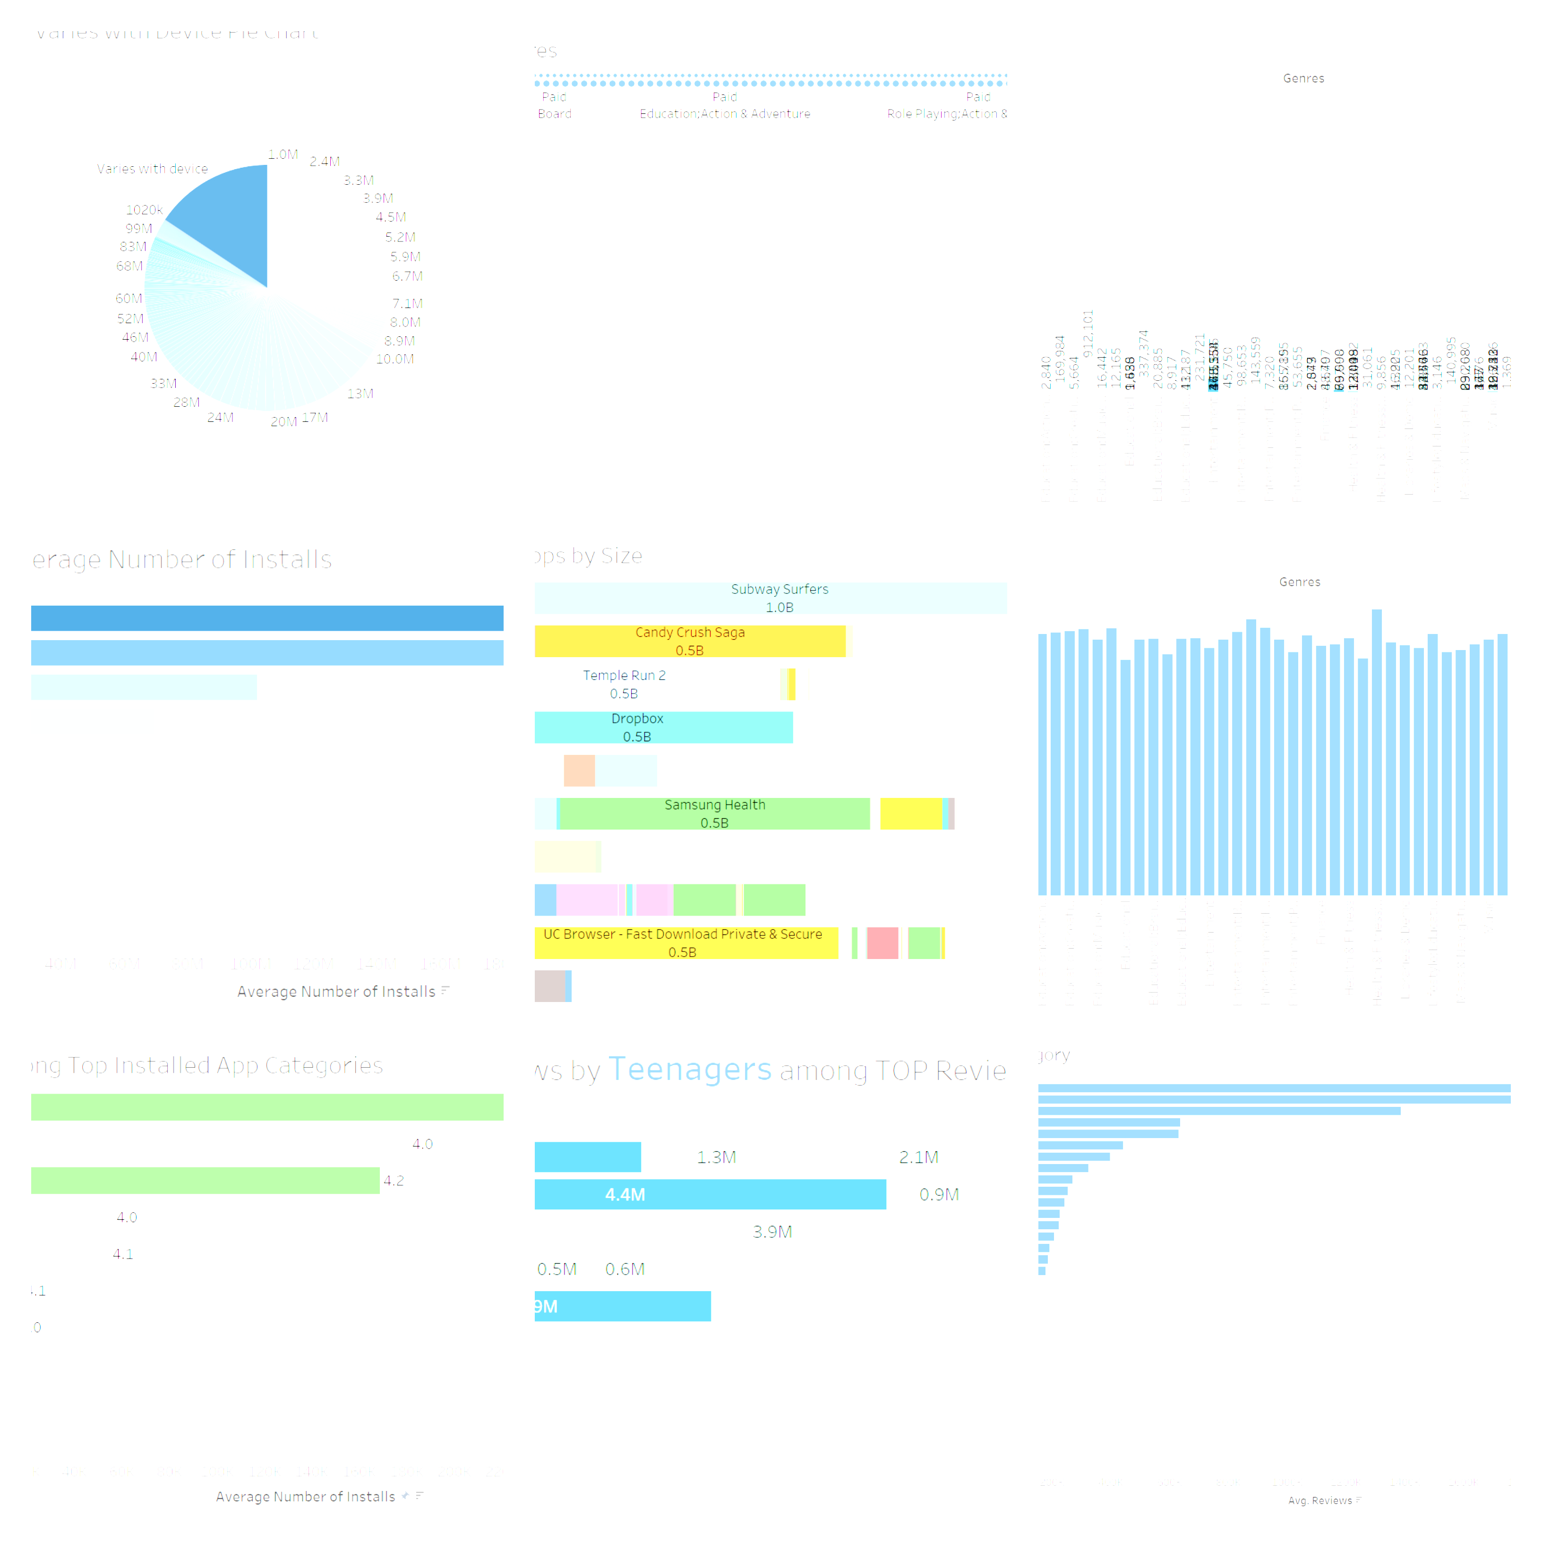
Insights
1
2
3
Teenage Behaviour
Rating Disparity
Subway Surfers is King ?

Slide 3
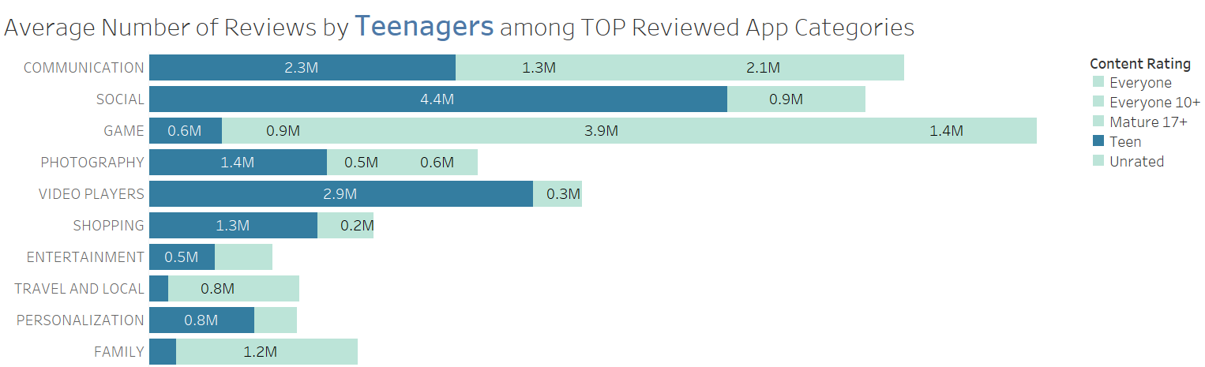
Teenage Behaviour
Contrary to popular belief, Teenagers do not play/interact with a lot of Games (just 0.6M out of 7M). Instead they voice their opinions through 4.4M reviews regarding Social apps.
They seem to be huge consumers of Video Players, which is demonstrated by 2.9M reviews where they provide feedback.
Therefore, in both of these App categories they lead all other age groups by over 80% in terms of reviews.

Slide 4
Rating Disparity
Although it has been established that Games are the most installed on the Play Store on average, they do not constitute the highest average rated category.
Instead, it is the News and Magazines category bagging the highest average rating of 4.8. This shows the trust and authenticity of information they find in news and magazines even today.

Slide 5
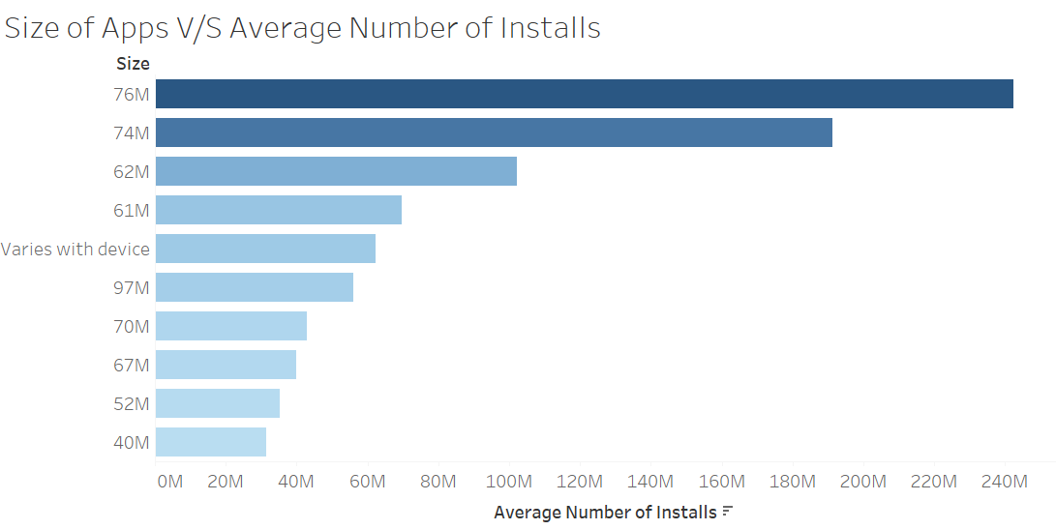
Subway Surfers is King ?
What are your initial thoughts on seeing this chart?
The top 2 most installed sizes are 76 and 74MB.
These numbers seem odd. Is it the case that there are so many apps with the same size down to the last MB? Are these magical numbers?
Let’s find out.

Slide 6
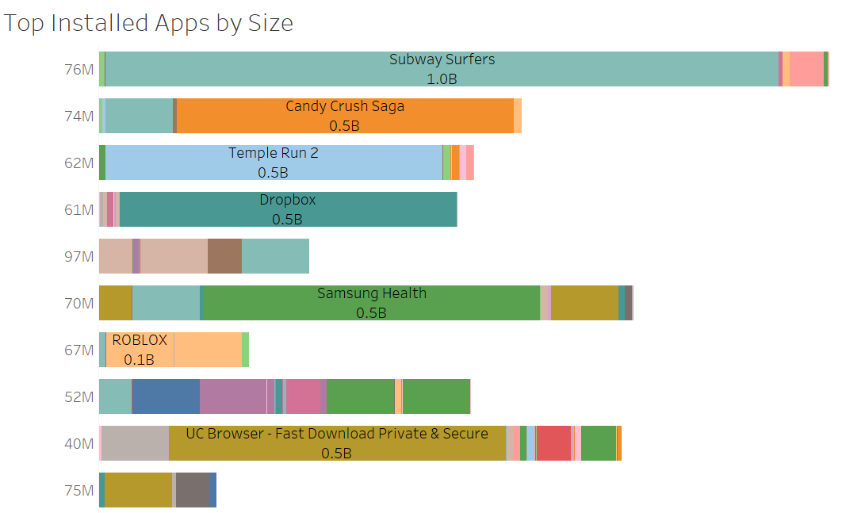
Subway Surfers is King ?
Here’s the interesting part. Around 90% of those installs for the 76MB app size category came just from one game – Subway Surfers (1 billion installs).
Other Games like Candy Crush and Temple Run also dominate their respective App size categories racking over half a billion installs

Slide 7
Visualisation/Decluttering Choice
Insight 3
The dataset provided encodes Size in the form of a string (where M represents MB) so it panned out as a categorical variable. I performed some pre-processing in Excel to remove the ‘+’ sign from the Installs column and convert it to an integer. Therefore in this case, when plotting between a categorical (Price) and numerical (Average number of Installs) variable, a horizontal bar chart seemed the plausible option. I added a Colour Mark to highlight the most installed App Sizes. In the second figure, I added Colour Marks by App Name and Text Marks Installs to showcase the app effectively.
For this insight, as well as others, I have done the following to declutter –
Dropped Grid Lines, Row Header Labels and Colour Legends where unnecessary to reduce cognitive load.
Dropped Y- axis in cases where I have already marked the information on the chart.
Maintained a colour scheme with gradient colours to emphasise intensities in values.

